Slide 1


ARCHITECTS THROUGH TIME PT. 2
Great Tour of Modernism

Slide 2
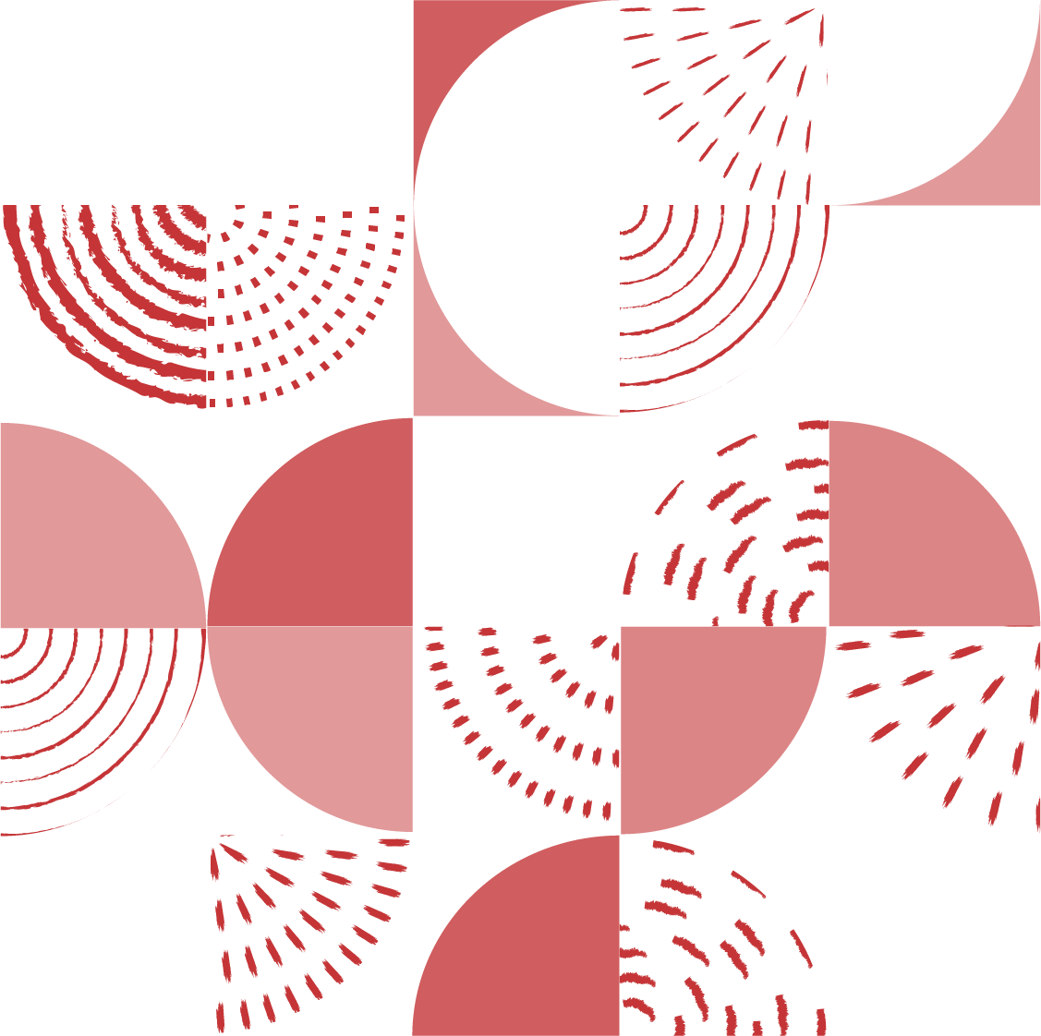
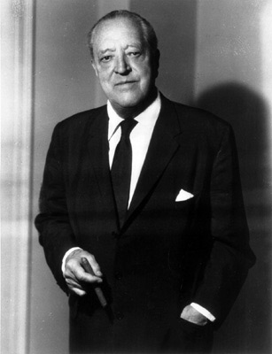
LUDWIG MIES VAN DER ROHE
“LESS IS MORE”
Aachen (GER) 1886 - Chicago (USA) 1969

Slide 3


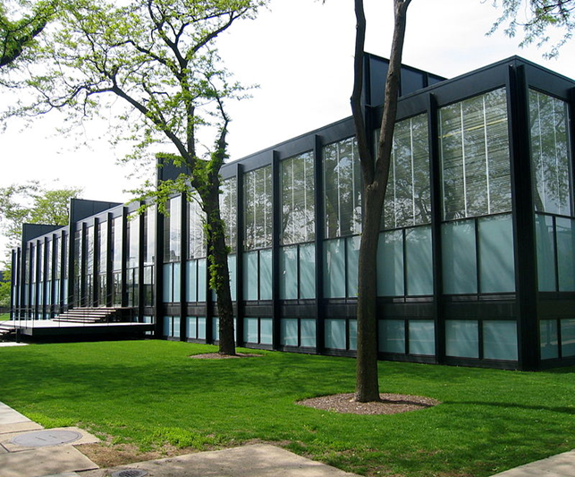
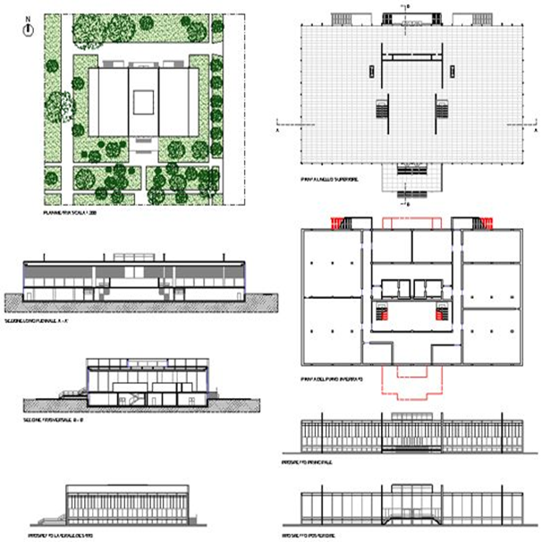
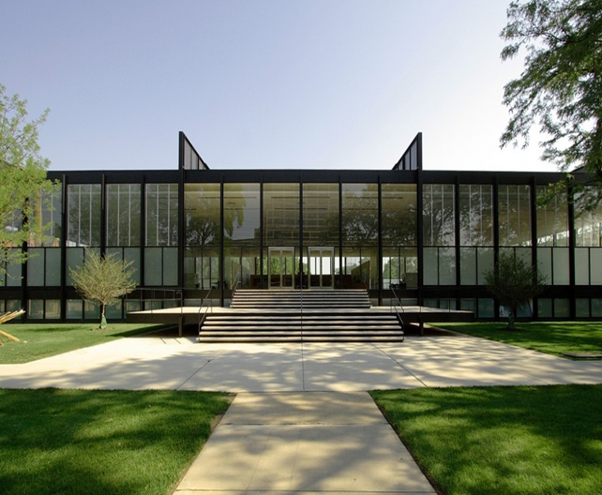
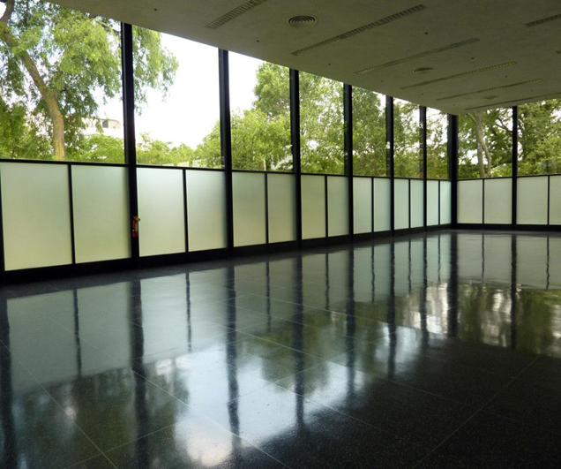
CROWN HALL
. The Crown Hall is one of the most interesting buildings on the entire campus of the Illinois Institute of Technology, a university complex designed by Mies van der Rohe and built on the outskirts of Chicago between 1939 and 1958.It is a single-span building 67 meters long, 36.5 meters deep and 5.4 meters high; a single indistinct internal work space of almost 2,500 square meters, enclosed between two suspended plates to an external structure.
OVERVIEW
TYPE PLANT
FACADE OF THE ENTRANCE
DETAIL

Slide 4
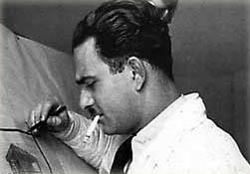
LUIGI COSENZA
MEDITERRANEAN RATIONALISM
Naples (IT) 1915 - 1984

Slide 5
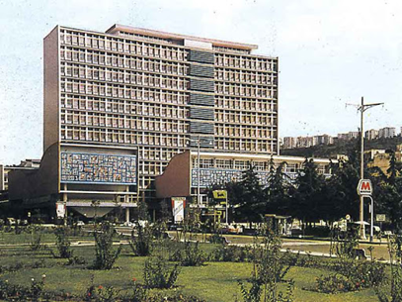
SCHOOL OF ENGINEERING MAIN BUILDING
NAPLES UNIVERSITY
The Building of Engineering Department is a vast construction complex that is located in Naples, in the area of Fuorigrotta. It was designed by Luigi Cosenza, Michele Pagano, Marcello Picone e Luigi Tocchetti between 1955 and 1970.
The Building comes up as the end of the public housing in viale Augusto. The structure, used as a facility for the Naples University Federico II, was designed by Cosenza to conceal the houses in the back with two eleven-story buildings organized around a courtyard. A wide mosaic decoration on the pediment celebrates the progress achieved by Man through his work.
FAÇADE OF THE ENTRANCE

Slide 6
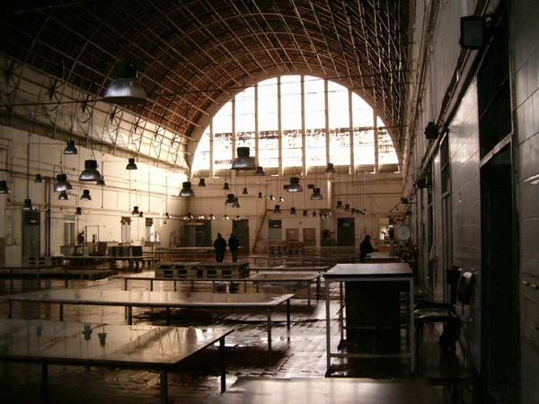
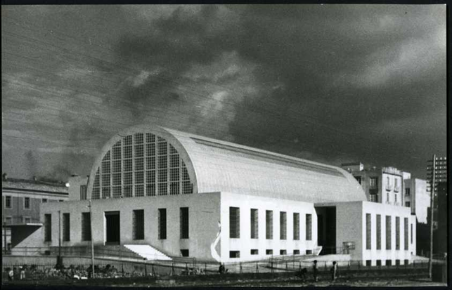
.
FISH MARKET
INDOOR
OUTDOOR

Slide 7
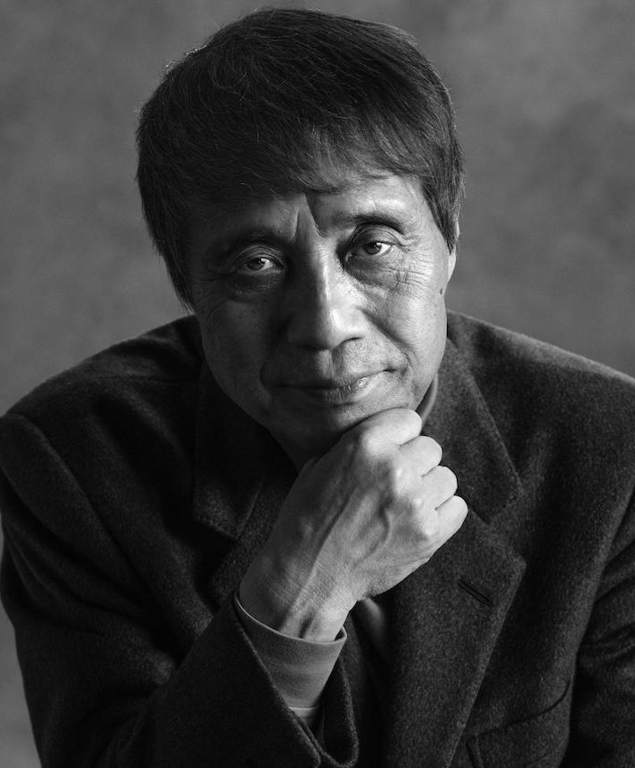
TADAO ANDO
ORIENTAL SENSE OF LIGHT
Osaka (JPN) 1941 -

Slide 8
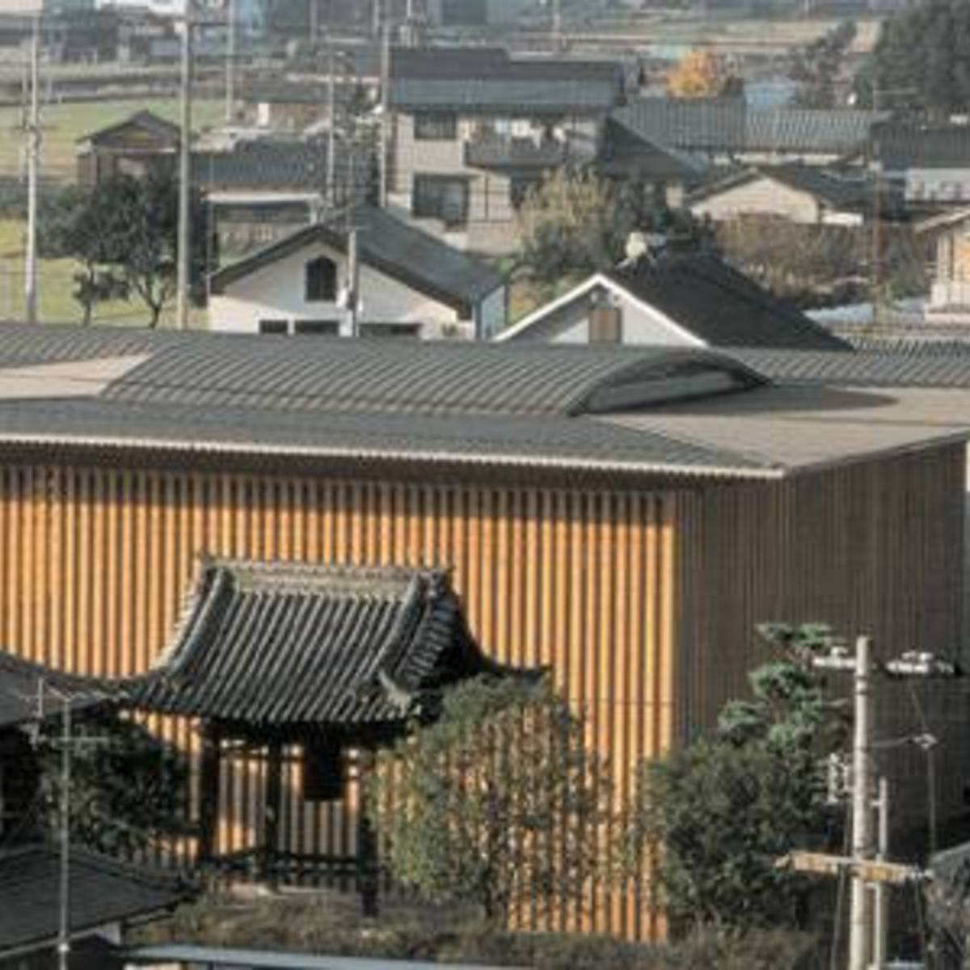
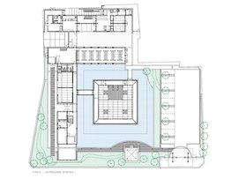
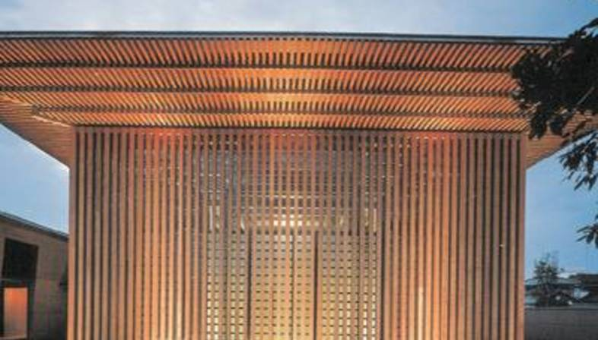
KOMYO-JI-SAIJO TEMPLE
Komyo-ji-Saijo temple was built in Ehime in Japan, on 28-08-2002. It was necessary to create a space suitable for community meetings and open to all, as well as rebuilding the guest room and quarters for the monks. The intent of the designers was to enhance the Japanese construction tradition understood as the assembly of many wooden elements, re-proposing the theme of a single structure made up of different parts, each full of tension. It was decided to create the building with a laminated wood structure capable of creating uniform effects and being used without waste. A large space covered by three layers of crossed beams was thus conceived, supported by a system of sixteen columns divided into four groups. Through the glass wall the light and the surrounding environment penetrate inside, while from the outside you have the perception of what is happening inside the building. The effect of lightness given by the use of wood is accentuated by the presence of water all around. Although permission was granted to eliminate the entrance pavilion and that of the bells, it was decided to leave them in their original location, so as not to affect the original geometric layout of the paths, preferring to abandon pure geometries and create a path that wind all around the pavilion.
OVERVIEW
TYPE PLANT
FACADE OF THE ENTRANCE

Slide 9

RENZO PIANO
ARCHITECTURAL TECHNOLOGY AND LANGUAGE
Pegli (IT), 1937 -

Slide 10
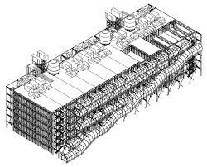
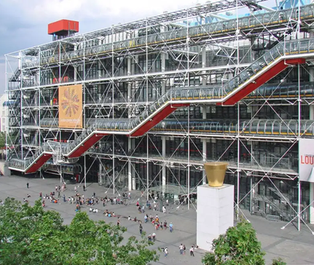
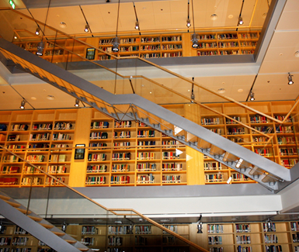
The National Centre of Art and Culture Georges Pompidou
The National Centre of Art and Culture Georges Pompidou (French: Beaubourg) is located in Paris. The building was designed by Piano and Rogers.
The construction of the Centre began in 1972 and was completed in 1977, then on january 31th there was the inauguration.
The exterior pipes' colours are differentiated according to their use: yellow represents electricity, red stands for elevators and escalators, green for water and blue refers to air system.
Today the Pompidou is one of the most visited museums in the world and it owns a collection of about 70 thousand works, in which design, architecture, photography and multimedia works are the most common themes. These works are proposed through constantly renewed exhibition forms and are often accompanied by cycles of conferences, meetings, debates, concerts and shows. Also, every year the Centre organizes about thirty monographic or thematic exhibitions, preparing temporary exhibitions.
TYPE PLANT
FACADE OF THE ENTRANCE
DETAIL

Slide 11

SANTIAGO CALATRAVA
FROM NATURE ARCHITECTURE TO CONSTRUCTION ENGINEERING
Benimámet (ESP) 1951 -

Slide 12
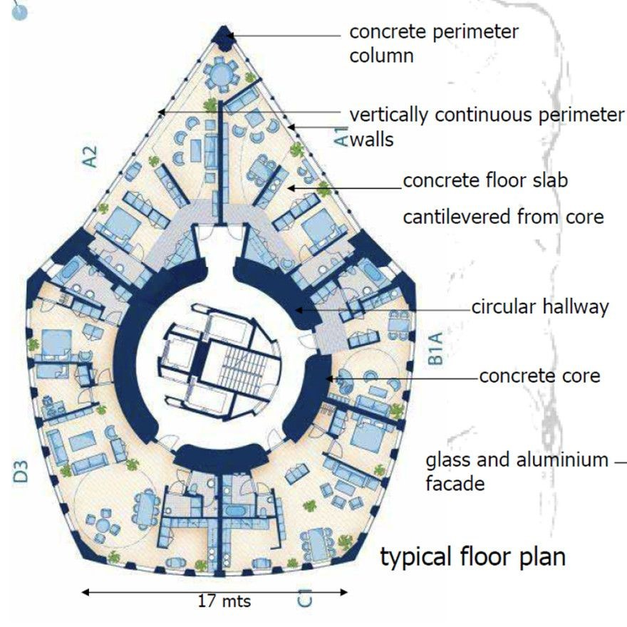
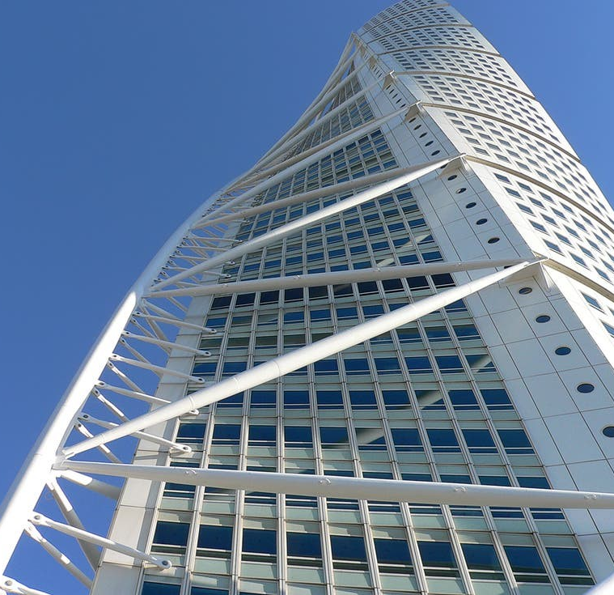
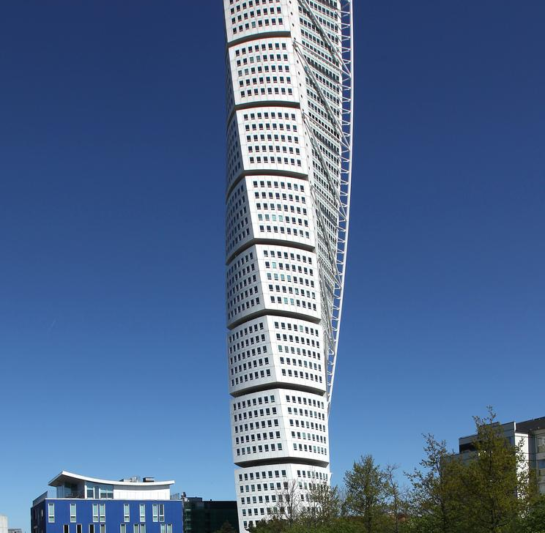
TWISTING TORSO
In 1999, Calatrava was invited to design a mixed-use residential tower for a prominent site in Malmö's Western Harbor area and was planned to be exhibited during the European Housing Expo 2001 (Bo01). The project was envisioned as an important part of the transformation program of Malmö's Western Harbor near the A–resund Bridge connecting to Sweden and Denmark. Given the opportunity to enhance and enlarge a public area defined by the intersection of two main roads, Calatrava conceived his project as a free-standing sculptural element posed within the cityscape.
TYPE PLANT
FACADE OF THE ENTRANCE
OVERVIEW

Slide 13
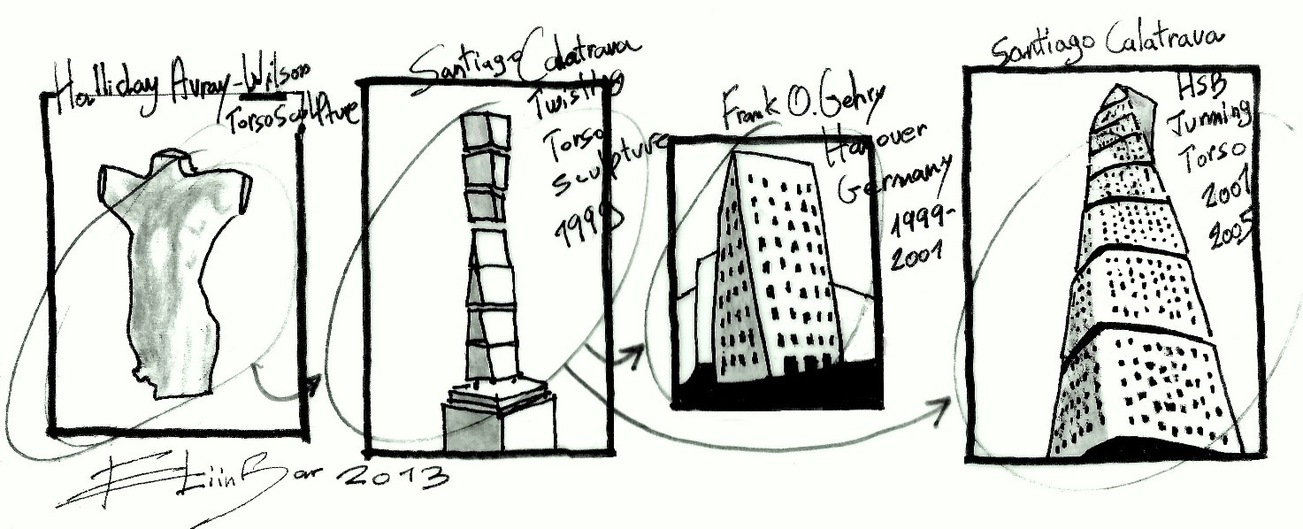
Turning Torso is based on a sculpture by Calatrava, called Twisting Torso, which is a white marble piece based on the form of a twisting human being. It is the first "twisting" tower.

Slide 14
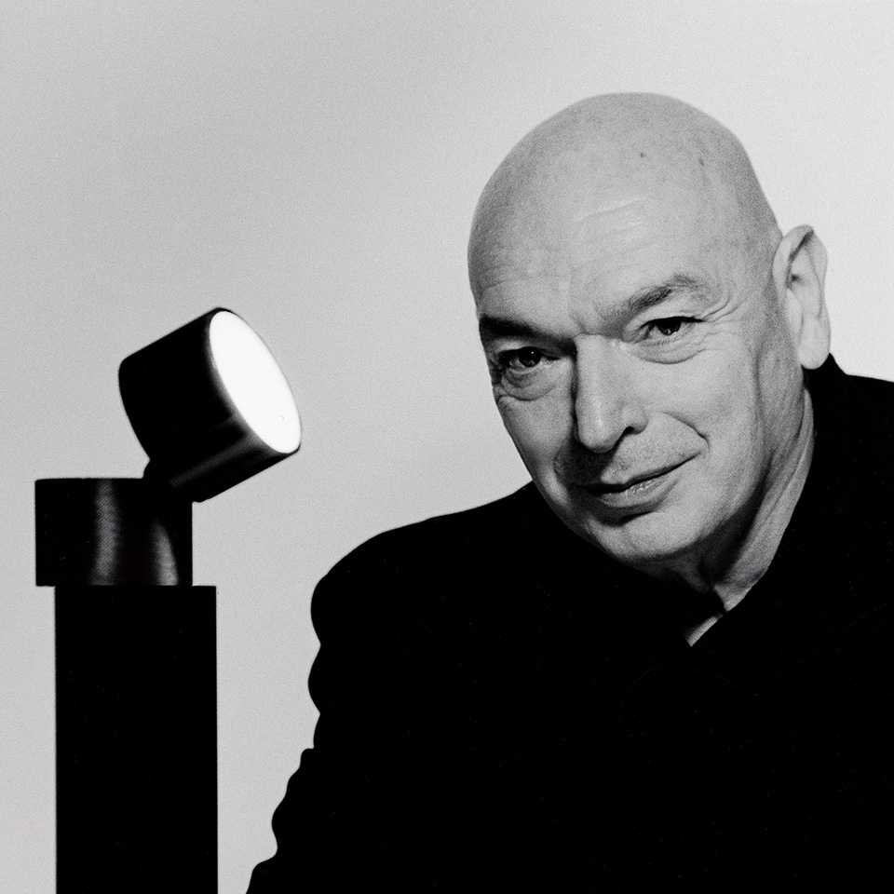
.
.
JEAN NOUVEL
MYSTERY OF MODERN ARCHITECTURE
Fumel (FRA) 1945 -

Slide 15
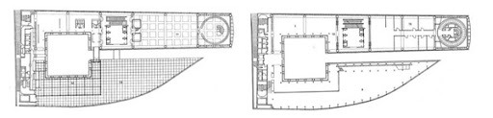
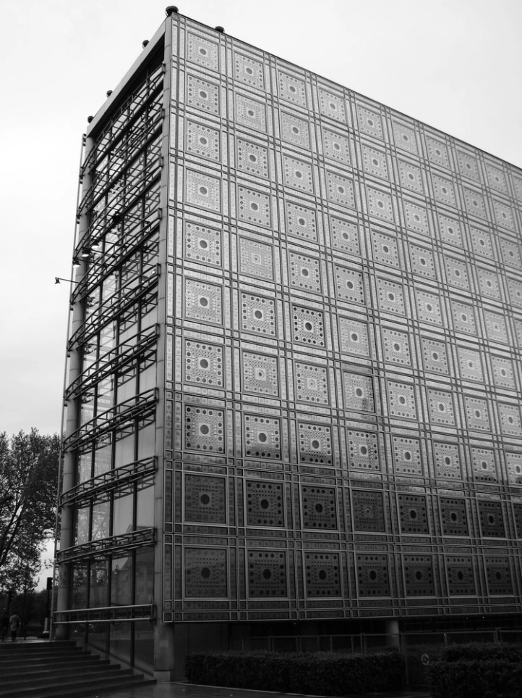
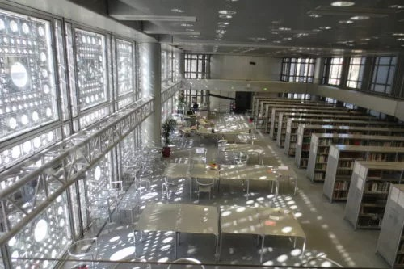
ARAB WORLD INSTITUTE
The building's atrium is in the center of the ground floor to the south, bordered by four reinforced concrete pillars and a polished steel floor, like the restaurant located below. Start six stairs and elevators, which form an open space that goes up all the houses are located. The AWI is divided into eleven floors above ground and three underground. The northern part has a total of nine. They are generally short to medium in height, except double. Its spaces alternate with terraces and floors, such as the library and the northern part of the fourth floor where there is also a small balcony overhang. In some areas of the museum, to the north, the roof is reassembled. From the fourth floor of the building the two bodies are connected by a band on the east side, as well as two bridges placed at different heights. It is on this floor where, on the east side, the cavity that divides the two sides is close to a square courtyard in which there are boxes. In the basement there is a large auditorium, a hypostyle hall and temporary exhibitions. These units extend below the square south of the topmost part of the IMA.
TYPE PLANT
FAÇADE OF THE ENTRANCE
DETAIL

Slide 16


LICEO G.GALILEI NAPOLI
ERASMUS+ CLASS
Architecture - a journey
through time and space.
BATTIMELLI VALERIA
BIOCCHI ALESSANDRA
CAPUOZZO ALESSIA
MELLINO ALESSIA
NEVANO CHIARA
NOCERINO DANIELA

